Slide 1
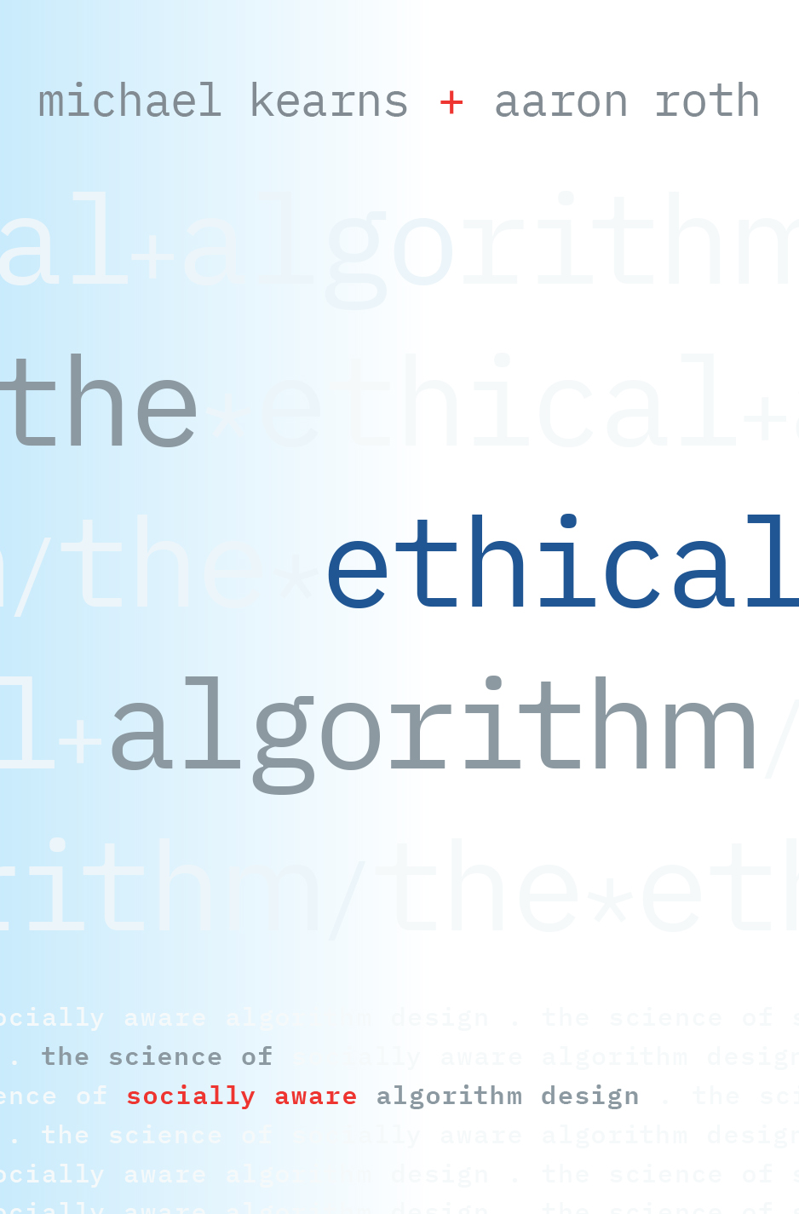
Konrad’s Class
April 23, 2020

Slide 2
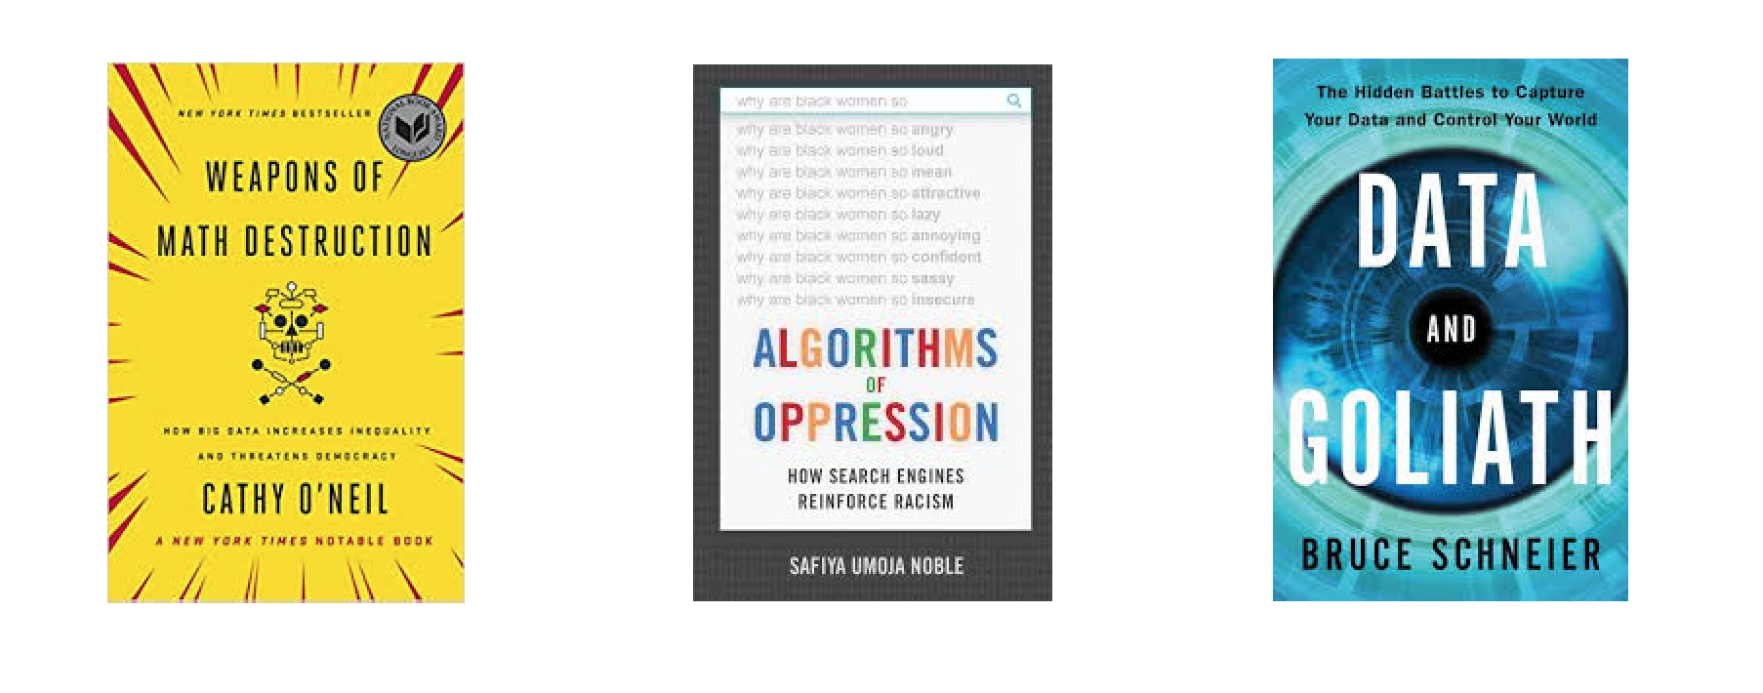

Slide 3

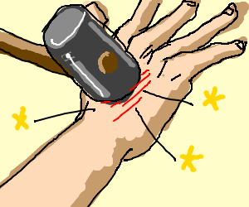
Ethical Algorithms?

Slide 4
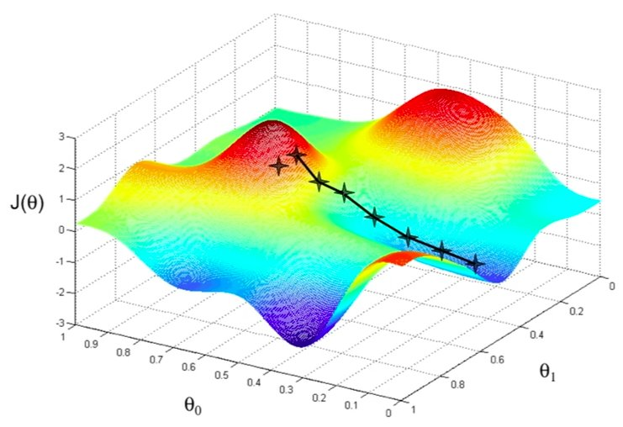
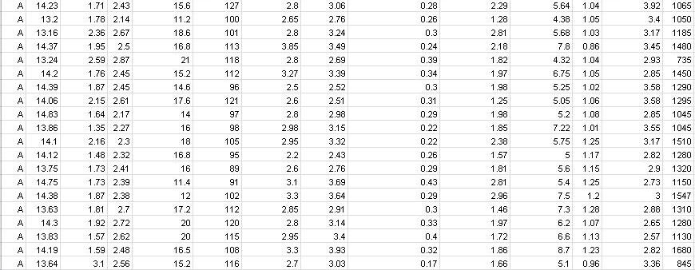

Algorithms: Hard to Assign Blame

Slide 5
Need to Embed Social Values
in Algorithms
Requires being precise about definitions, developing their consequences.
Privacy
Fairness
Accountability
Interpretability
Morality

Slide 6
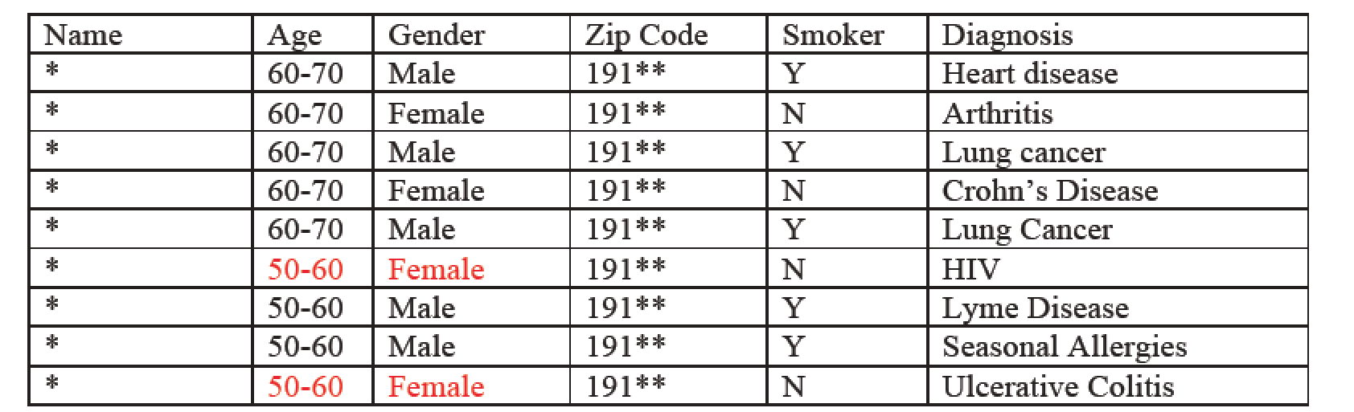
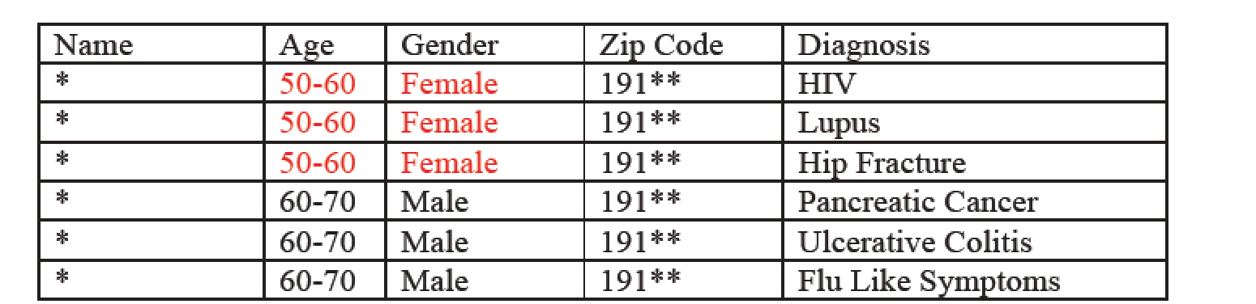
“Anonymized Data Isn’t”

Slide 7
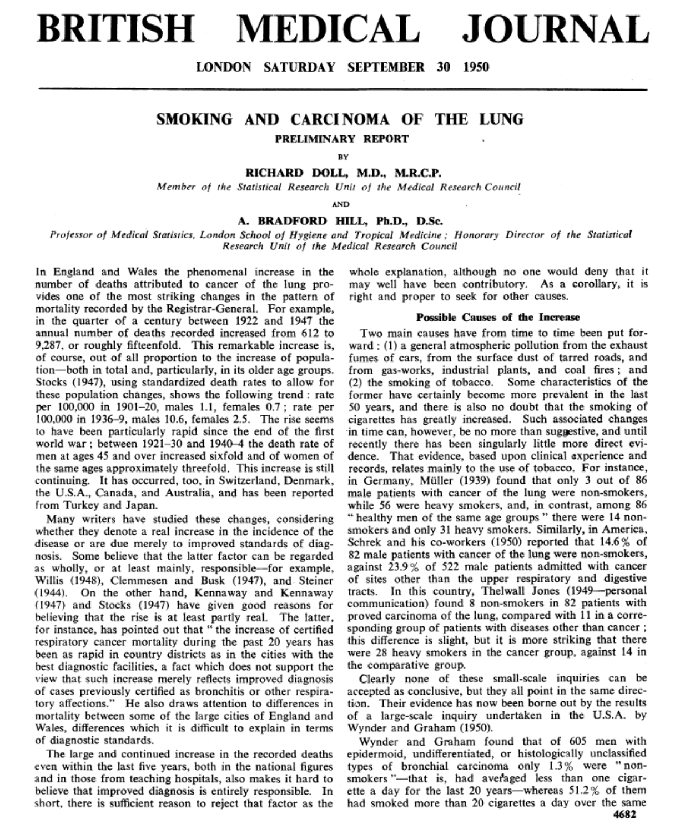

Slide 8
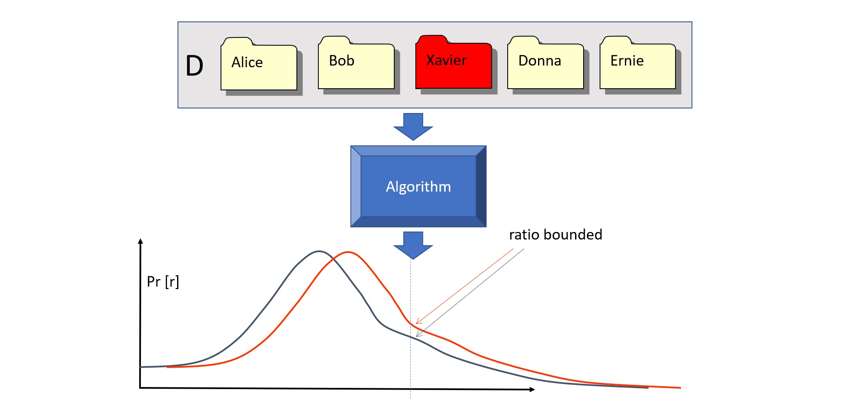
Differential Privacy

Slide 9
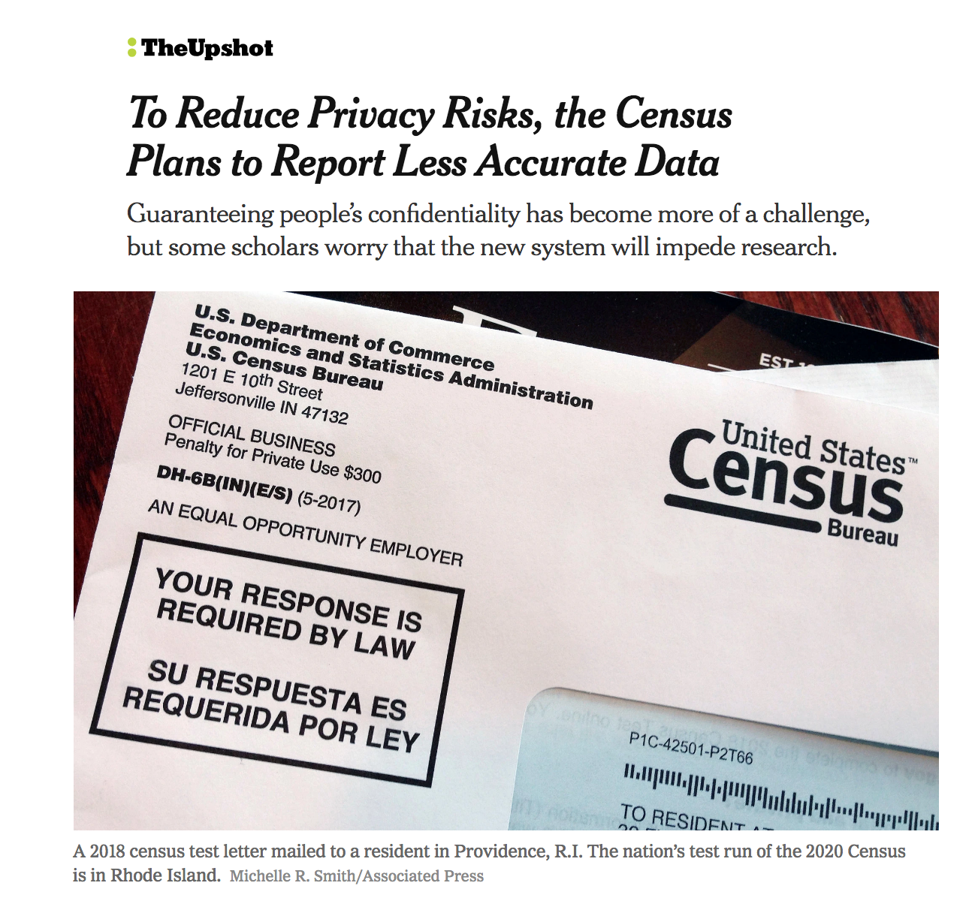

Slide 10


Slide 11
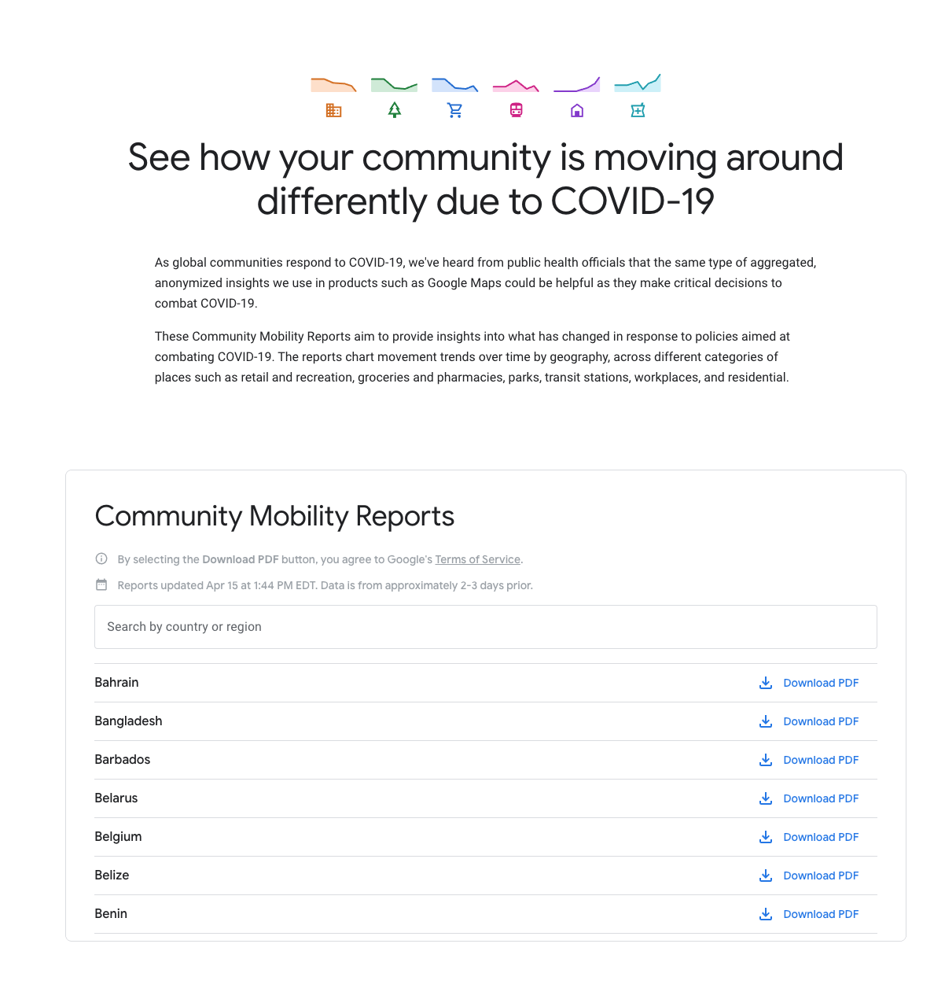

Slide 12
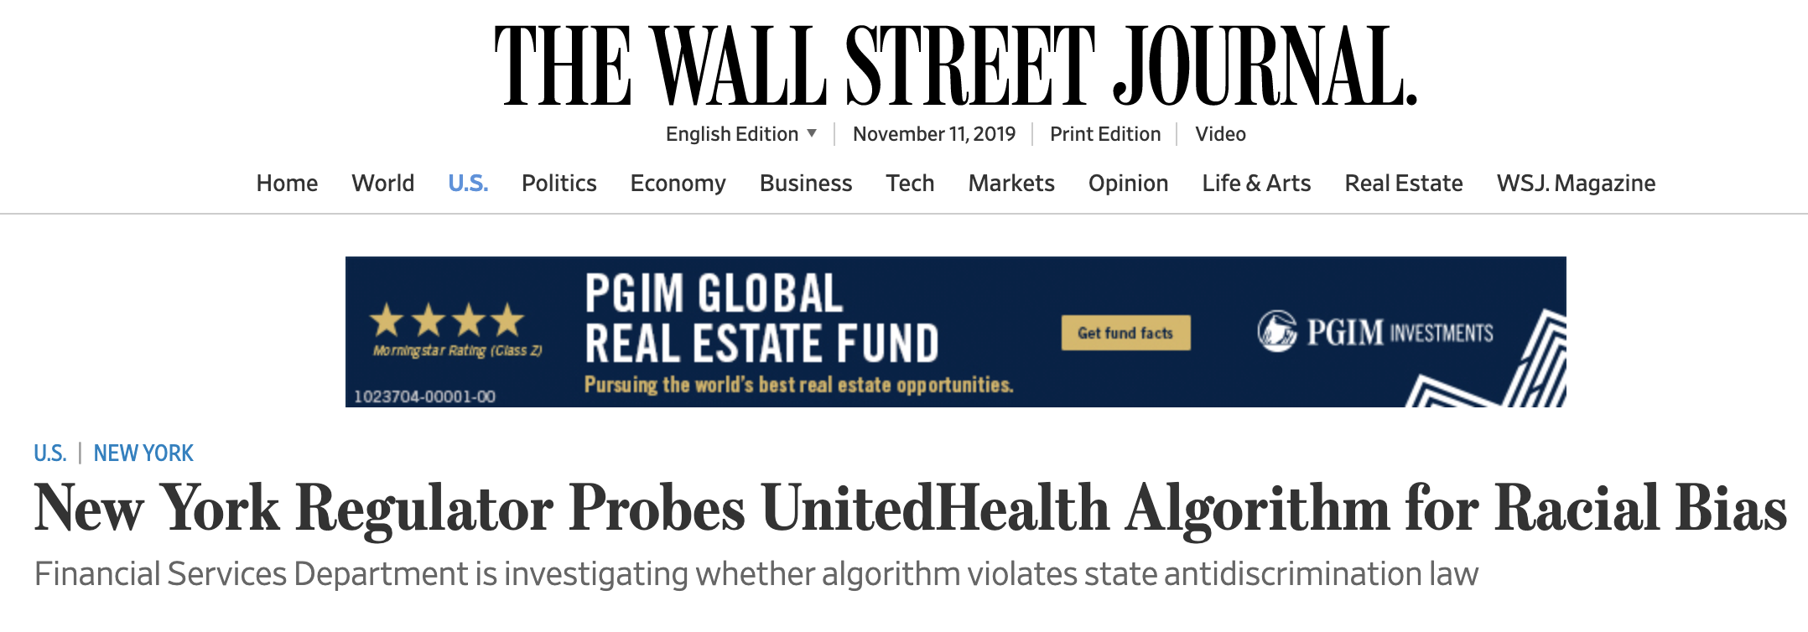
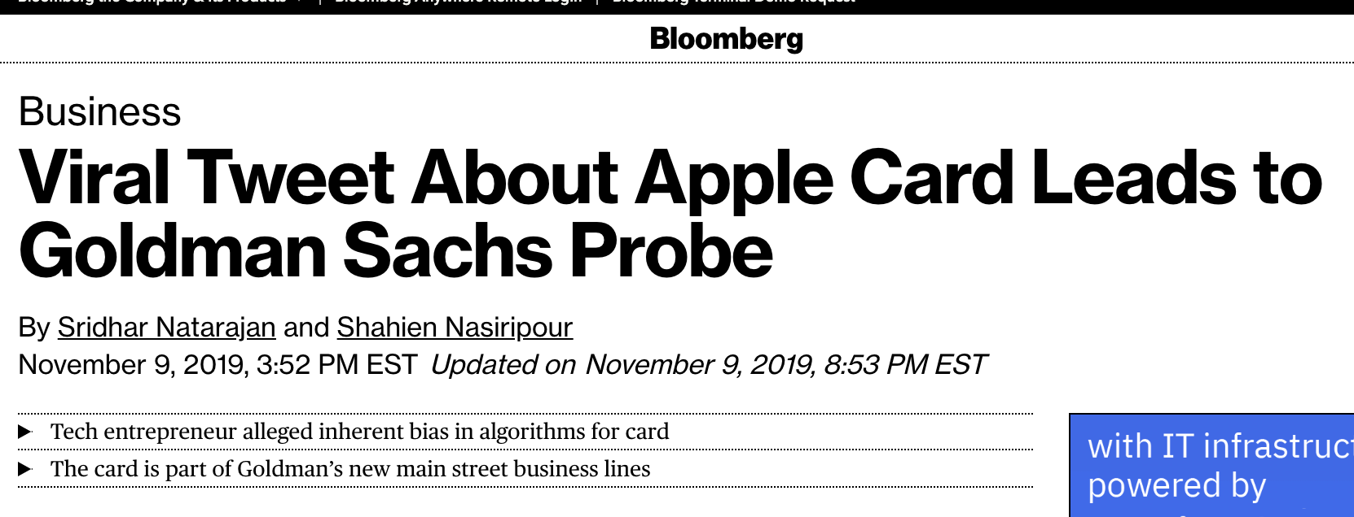
Fairness: A Work in Progress
Don’t agree on the definitions.
Only beginning to understand tradeoffs between different kinds of fairness, and between fairness and accuracy.
Why might machine learning be “unfair”?

Slide 13
SAT Score
GPA
Population 1
Population 2

Slide 14
SAT Score
GPA
Population 1
Population 2

Slide 15
SAT Score
GPA
Population 1
Population 2

Slide 16
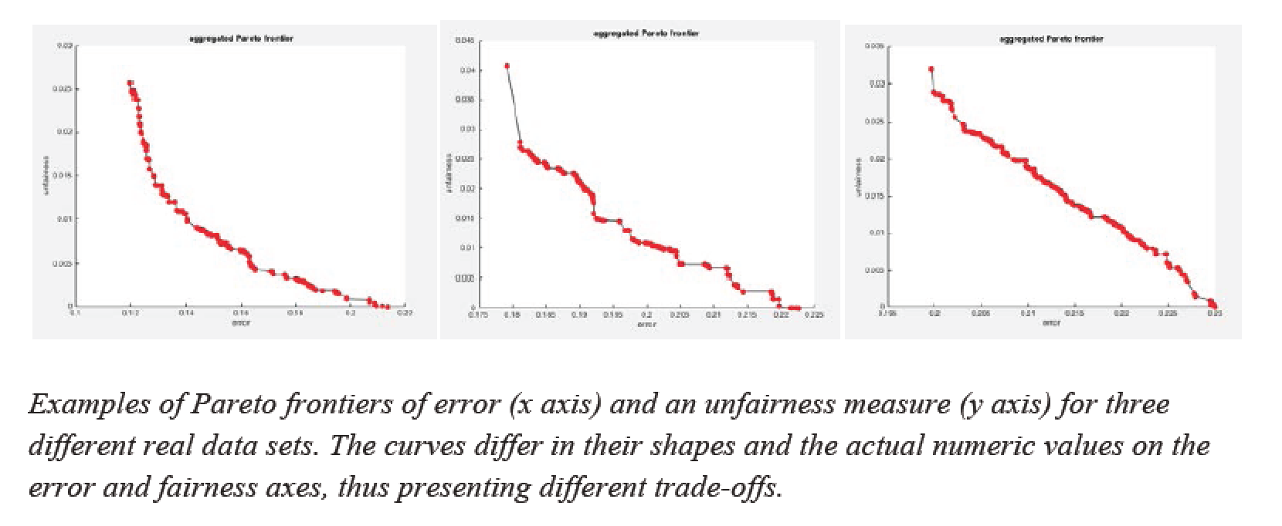
Efficient Frontiers

Slide 17
Other Topics
Games People Play (with Algorithms)
Games Scientists Play (with Data)
Interpretability, Accountability, Morality…. The Singularity

Slide 18
Frontiers of Fairness:
From Groups to Individuals
Joint works with Chris Jung, Seth Neel, Aaron Roth, Saeed Sharifi, Logan Stapleton, Steven Wu

Slide 19
Types of Fairness Definitions
Group Fairness
E.g. equality of error or false negative rates across gender, racial groups, etc.
Strong theory, practical implementations (e.g. fairness regularization)
But no guarantees to individuals
Individual Fairness
E.g. metric fairness (“fairness through awareness”), meritocratic fairness
Binds at the individual level
But strong assumptions required (e.g. realizability) have prevented practical implementations

Slide 20
A Framework for Fair ML
Begin by expressing training as a (linear or convex) constrained optimization problem
E.g. minimize error subject to various fairness constraints
In interesting cases, model space of learning algo and number of constraints may be exponential/infinite
Want to avoid explicit enumeration
Use LP duality to pass to Lagrangian and recast as two-player, zero-sum game
Learner/Primal: wants to minimize error subject to constraints so far
Regulator/Dual: presents learner with violated constraints
Nash equilibrium is solution to constrained optimization problem
If we can:
Formulate best responses as instances of cost-sensitive classification
Implement at least one player as a no-regret algorithm w.r.t. their strategy space
… then algorithm provably converges in polynomial time given access to a standard learning heuristic
Directly implement on top of your favorite “unfair” learning algorithm
Applications:
Preventing “fairness gerrymandering”
Subjective individual fairness
Average individual fairness

Slide 21
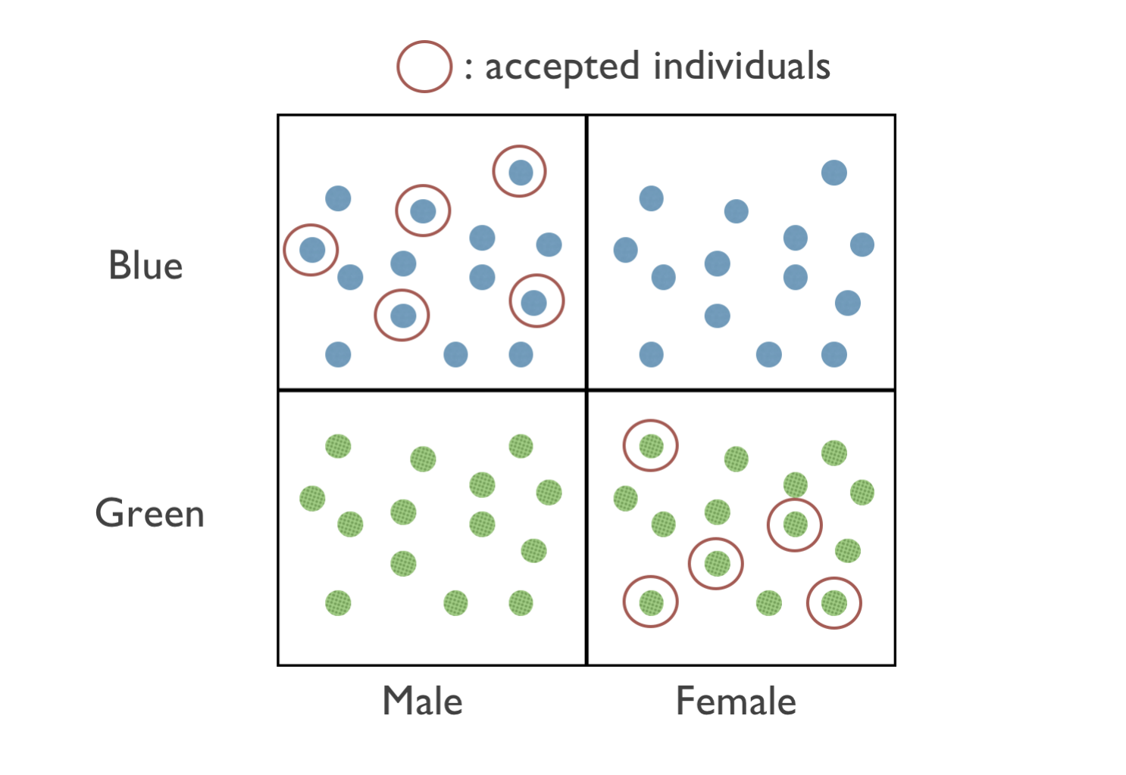
Preventing “Fairness Gerrymandering”

Slide 22
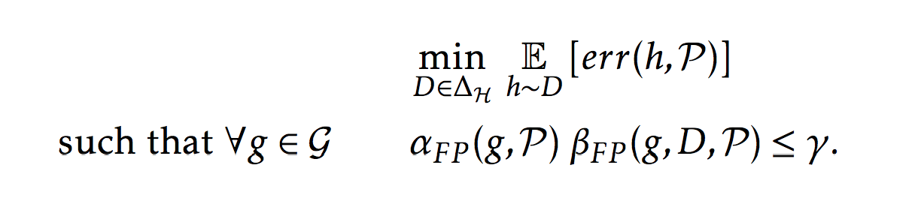
Interpolating Between Groups and Individuals
Problem: achieving group fairness by subgroup discrimination
E.g. disabled Hispanic women over age 55
N.B. Facebook hate speech policy
No reason to expect it won’t happen under standard fairness notions
But cannot generally protect arbitrarily refined subgroups (e.g. individuals)
Constrained optimization problem:

Slide 23
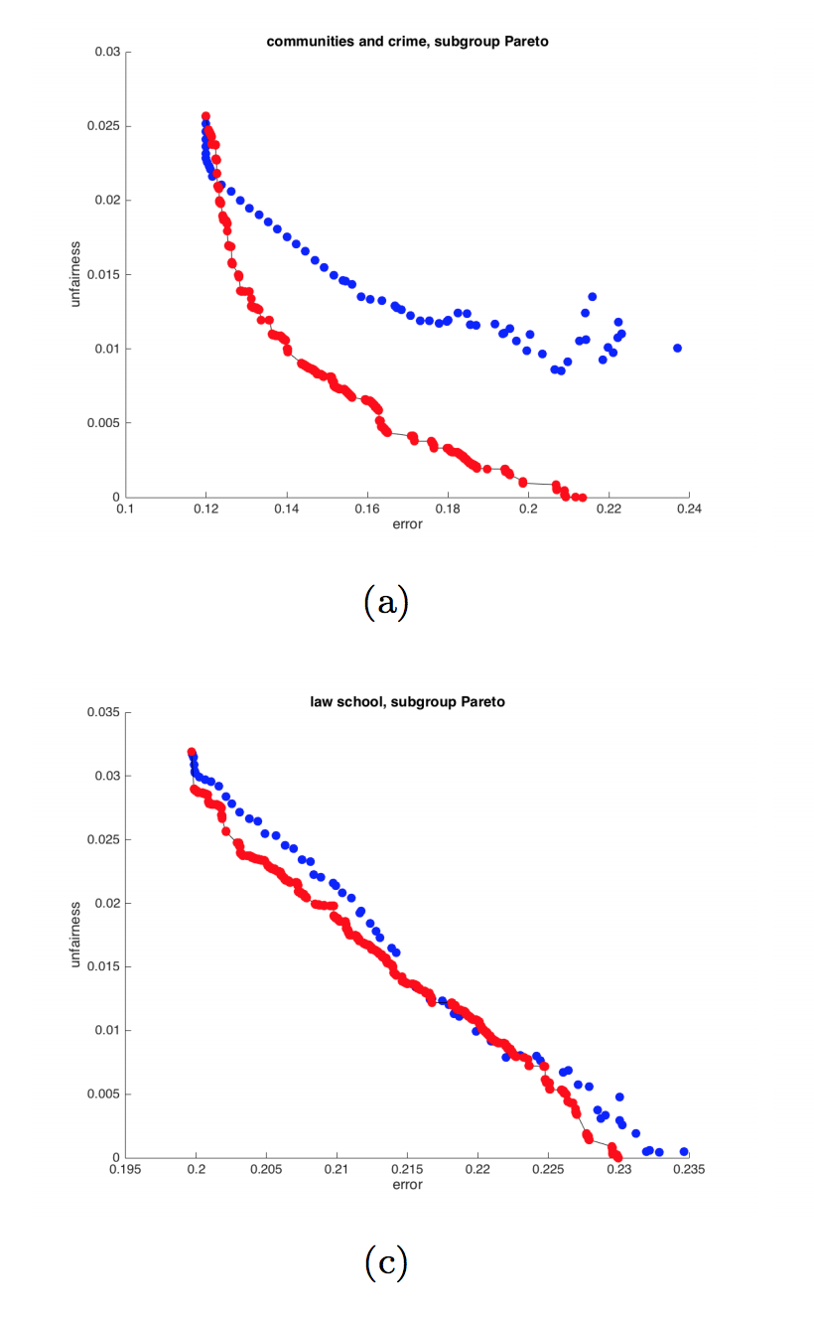
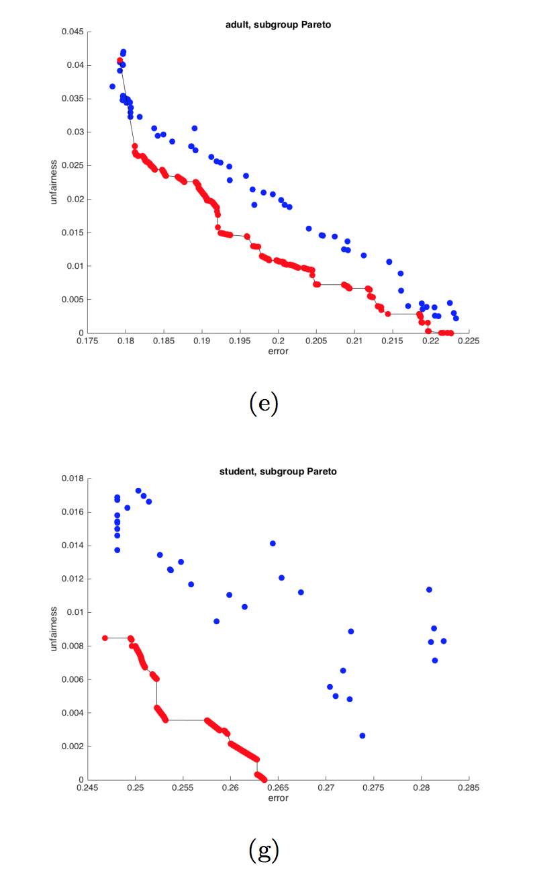
Pareto Frontiers

Slide 24
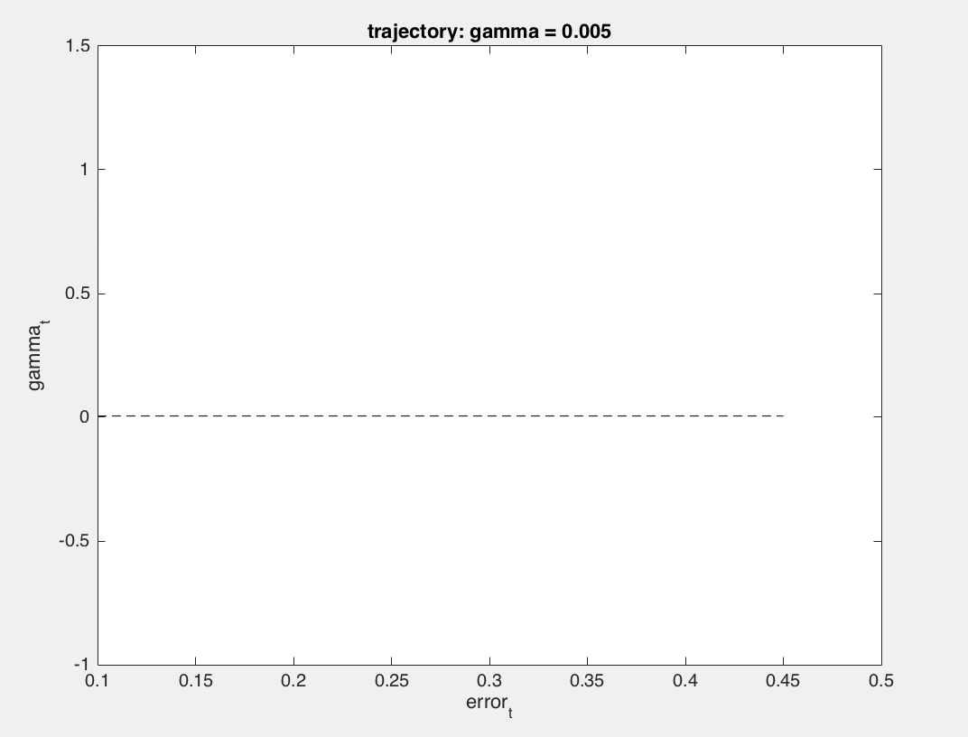
Error-Unfairness Trajectory

Slide 25
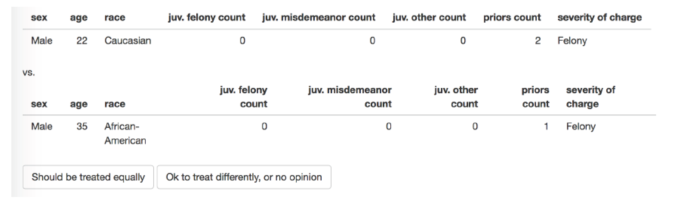
Subjective Individual Fairness

Slide 26
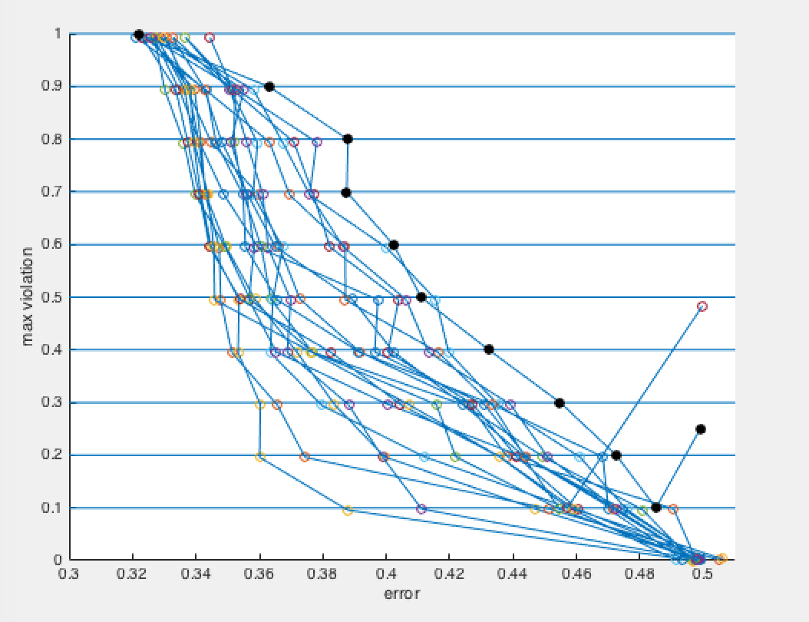
Pareto for the People

Slide 27
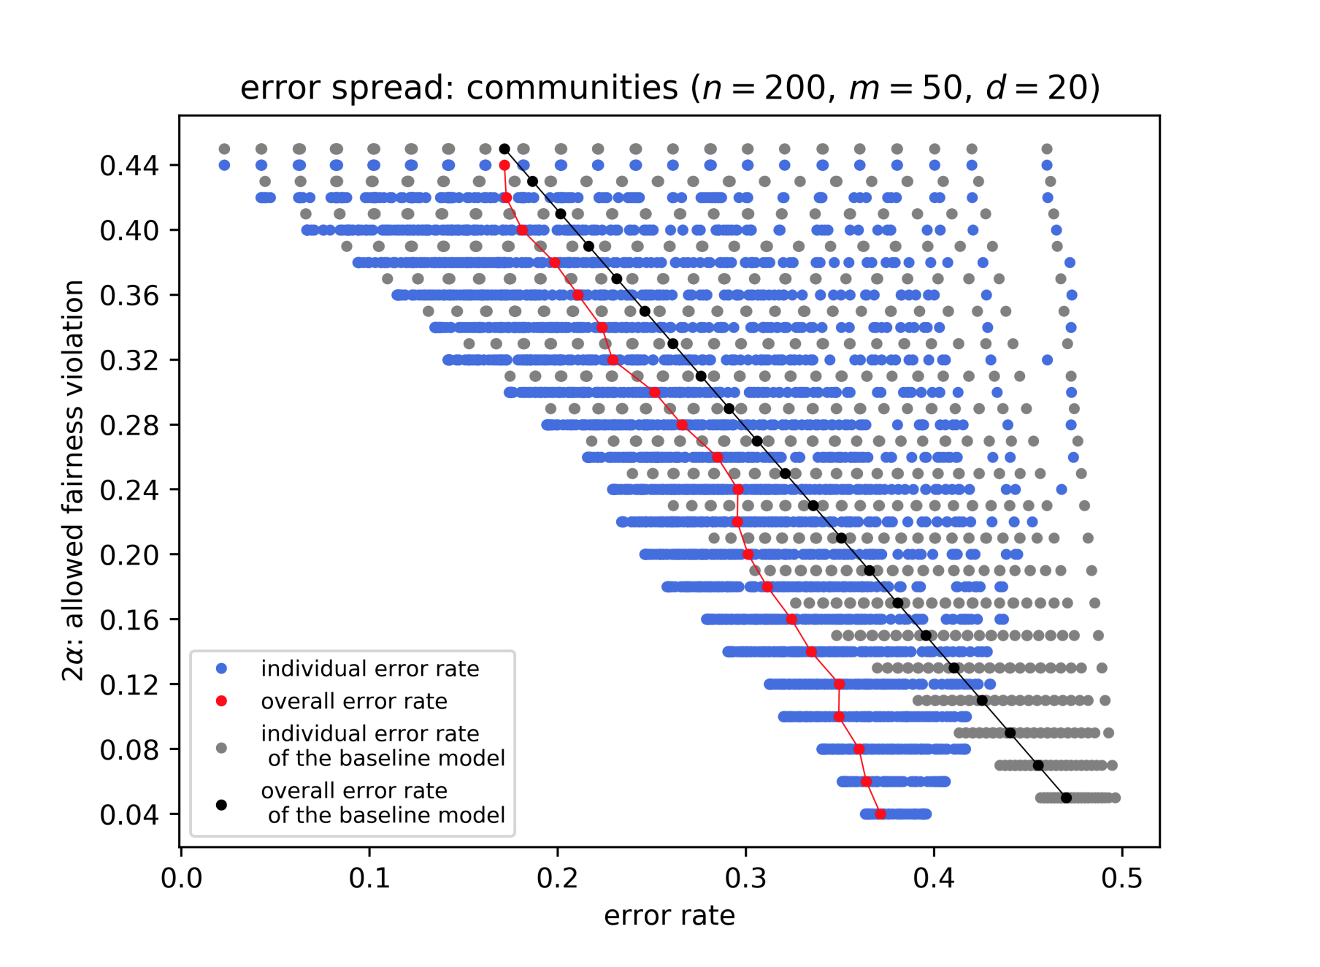
Average Individual Fairness

